Slide 1
Relationship in Java

Slide 2
Relationship
Type of relationship always makes to understand how to reuse the feature from one class to another class.
Based on reusing the data members from one class to another class in JAVA we have three types of relationships.
They are
Is-A Relationship
Has-A Relationship
Uses-A Relationship

Slide 3
Relationship
Is-a relationship is one in which data members of one class is obtained into another class through the concept of inheritance.
Has-a relationship is one in which an object of one class is created as a data member in another class.
Uses-a relationship is one in which a method of one class is using an object of another class.

Slide 4
Inheritance
Inheritance is the process of creating new classes from the exiting class without modifying the existing one.
It enables us to reuse code.

Slide 5
Is-A relationship
In Is-A relationship one class is obtaining the features of another class by using inheritance concept with extends keywords.
In a IS-A relationship there exists logical memory space.
This refers to inheritance or implementation.
Expressed using keyword “extends”.
Main advantage is code reusability.

Slide 6
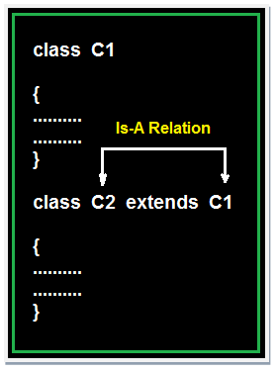
Syntax for Inheriting the features from base class to derived class:
class<clsname-2>extends<clsname-1>
{
Variable declaration;
Method definition;
};

Slide 7
Example of Is-A Relation
class Faculty
{
float salary=30000;
}
class Science extends Faculty
{
float bonus=2000;
public static void main(String args[])
{
Science obj=new Science(); System.out.println("Salary is:"+obj.salary); System.out.println("Bonus is:"+obj.bonus);
}
}
Output:
Salary is: 30000.0
Bonus is: 2000.0

Slide 9
HAS-A Relationship
Has-A means an instance of one class “has a” reference to an instance of another class or another instance of same class.
It is also known as “composition” or “aggregation”.
There is no specific keyword to implement HAS-A relationship but mostly we are depended upon “new” keyword.

Slide 10
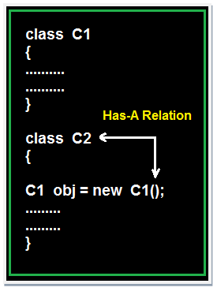
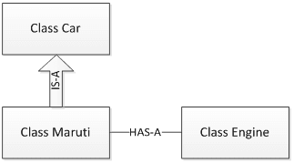
Composition(HAS-A) simply mean the use of instance variables that are references to other objects. For example Maruti has Engine, or House has Bathroom.
Let’s understand these concepts with an example of Car class.

Slide 11
package relationships;
class Car
{
String color;
private int maxSpeed;
public void carInfo()
{
System.out.println("Car Color= "+color + " Max Speed= " + maxSpeed);
}
public void setColor(String color)
{
this.color = color;
}
public void setMaxSpeed(int maxSpeed)
{
this.maxSpeed = maxSpeed;
}
}

Slide 12
class Maruti extends Car
{
public void MarutiStartDemo()
{
Engine MarutiEngine = new Engine(); MarutiEngine.start();
}
}
package relationships;
public class Engine
{
public void start()
{ System.out.println("Engine Started:");
}
public void stop()
{ System.out.println("Engine Stopped:");
}
}

Slide 13
package relationships;
public class RelationsDemo
{
public static void main(String[] args)
{
Maruti myMaruti = new Maruti();
myMaruti.setColor("RED");
myMaruti.setMaxSpeed(180);
myMaruti.carInfo();
myMaruti.MarutiStartDemo();
}
}
Relations Demo class is making object of Maruti class and initialized it.
Though Maruti class does not have setColor(), setMaxSpeed() and carInfo() methods still we can use it due to IS-A relationship of Maruti class with Car class.

Slide 14
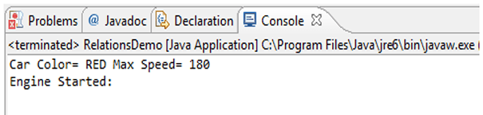
If we run Relations Demo class we can see output like below.

Slide 15
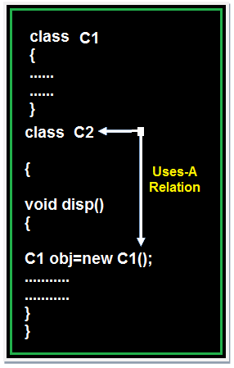
Uses-A relationship
A method of one class is using an object of another class the relationship between these two classes is known as Uses-A relationship.

Slide 16
Uses-A relationship
As long as the method is in execution the object space (o1) exists and once the method execution is completed automatically object memory space will be destroyed.

Slide 17
Example of Uses-A Relation
class Employee
{
float salary=30000;
}
class Salary extends Employee
{
void disp()
{
float bonous=1000;
Employee obj=new Employee();
float Total=obj.salary+bonous;
System.out.println("Total Salary is:"+Total);
}
}
class Developer
{
public static void main(String args[])
{
Salary s=new Salary(); s.disp();
}
}
output :
Total Salary is: 31000.0

Slide 18
Notes
Note 1: The default relationship in java is Is-A because for each and every class in java there exist an implicit predefined super class is java.lang.Object.
Note 2: The universal example for Has-A relationship is System.out (in System.out statement, out is an object of printStream class created as static data member in another system class and printStream class is known as Has-A relationship).

Slide 19
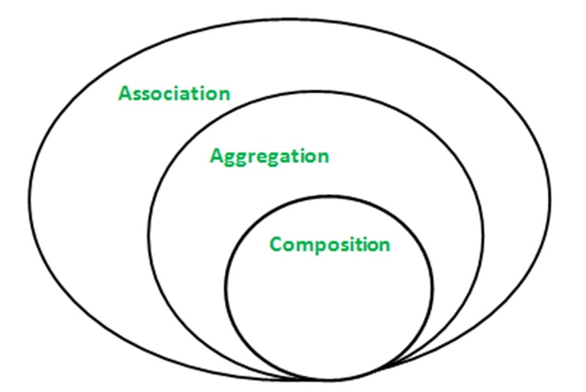
Association, Composition and Aggregation in Java
Association is relation between two separate classes which establishes through their Objects. Association can be one-to-one, one-to-many, many-to-one, many-to-many.
In Object-Oriented programming, an Object communicates to other Object to use functionality and services provided by that object. Composition and Aggregation are the two forms of association.

Slide 20
Java program to illustrate the concept of Association
// class bank
class Bank
{
private String name;
// bank name
Bank(String name)
{
this.name = name;
}
public String getBankName()
{
return this.name;
}
}
// employee class
class Employee
{
private String name;
// employee name
Employee(String name)
{
this.name = name;
}
public String getEmployeeName()
{
return this.name;
}
}

Slide 21
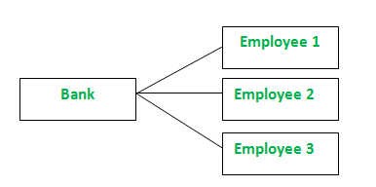
// Association between both the
// classes in main method
class Association
{
public static void main (String[] args)
{
Bank bank = new Bank("Axis");
Employee emp = new Employee("Neha");
System.out.println(emp.getEmployeeName() +
" is employee of " + bank.getBankName());
}
}
Output
Neha is employee of Axis
In above example two separate classes Bank and Employee are associated through their Objects. Bank can have many employees, So it is a one-to-many relationship.

Slide 22
Aggregation
It represents Has-A relationship.
It is a unidirectional association i.e. a one way relationship. For example, department can have students but vice versa is not possible and thus unidirectional in nature.
In Aggregation, both the entries can survive individually which means ending one entity will not effect the other entity

Slide 23
public class Address {
String city,state,country;
public Address(String city, String state, String country) {
this.city = city;
this.state = state;
this.country = country;
}
}
public class Emp {
int id;
String name;
Address address;
public Emp(int id, String name,Address address) {
this.id = id;
this.name = name;
this.address=address;
}
void display(){
System.out.println(id+" "+name);
System.out.println(address.city+" "+address.state+" "+address.country);
}
public static void main(String[] args) {
Address address1=new Address("gzb","UP","india");
Address address2=new Address("gno","UP","india");
Emp e=new Emp(111,"varun",address1);
Emp e2=new Emp(112,"arun",address2);
e.display();
e2.display();
}
}

Slide 24
Composition
Composition is a restricted form of Aggregation in which two entities are highly dependent on each other.
It represents part-of relationship.
In composition, both the entities are dependent on each other.
When there is a composition between two entities, the composed object cannot exist without the other entity.

Slide 25
Aggregation vs Composition
Dependency: Aggregation implies a relationship where the child can exist independently of the parent. For example, Bank and Employee, delete the Bank and the Employee still exist. whereas Composition implies a relationship where the child cannot exist independent of the parent. Example: Human and heart, heart don’t exist separate to a Human
Type of Relationship: Aggregation relation is “has-a” and composition is “part-of” relation.
Type of association: Composition is a strong Association whereas Aggregation is a weak Association.

Slide 26
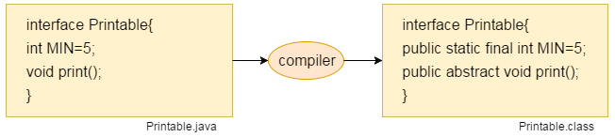
Interface in Java
An interface in java is a blueprint of a class. It has static constants and abstract methods.
The interface in Java is a mechanism to achieve Multiple inheritance and abstraction.
Interface fields are public, static and final by default, and the methods are public and abstract.

Slide 27
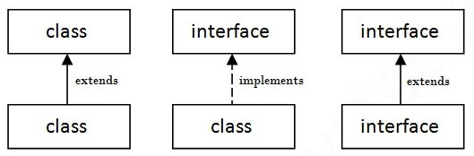
The relationship between classes and interfaces
As shown in the figure given below, a class extends another class, an interface extends another interface, but a class implements an interface.

Slide 28
Mcqs
1.Which is true?
A "X extends Y" is correct if and only if X is a class and Y is an interface
B. "X extends Y" is correct if and only if X is an interface and Y is a class
C."X extends Y" is correct if X and Y are either both classes or both interfaces
D. "X extends Y" is correct for all combinations of X and Y being classes and/or interfaces

Slide 29
2. What is the result of compiling and running the following code?
class Base{
public Base(){
System.out.print("Base");
}
}
public class Derived extends Base{
public Derived(){
this(“Smart");
System.out.print("Derived");
}
public Derived(String s){
System.out.print(s);
}
public static void main(String[] args){
new Derived();
}
}
A. SmartDerived
B. SmartBaseDerived
C. BaseSmartDerived
D. SmartDerivedBase
E. Compilation Error

Slide 30
3. class Mammal{
void eat(Mammal m){
System.out.println("Mammal eats food");
}
}
class Cattle extends Mammal{
void eat(Cattle c){
System.out.println("Cattle eats hay");
}
}
class Horse extends Cattle{
void eat(Horse h){
System.out.println("Horse eats hay");
}
}
public class Test{
public static void main(String[] args){
Mammal h = new Horse();
Cattle c = new Horse();
c.eat(h);
}
}
A. prints "Mammal eats food"
B. prints "Cattle eats hay"
C. prints "Horse eats hay"
D. Class cast Exception at runtime.
E. None of these

Slide 31
4. Determine output:
class A
{
public void method1(){
System.out.print("Class A method1");
}
}
class B extends A
{
public void method2()
{
System.out.print("Class B method2");
}
}
class C extends B
{
public void method2()
{
System.out.print("Class C method2");
}
public void method3()
{
System.out.print("Class C method3");
}
}
public class Test{
public static void main(String args[]){
A a = new A();
C c = new C();
c.method2();
a = c;
a.method3();
}
}
A. Class B method2 Class C method3
B. Class C method2 Class C method3
C. Compilation Error
D. Runtime exception
E. None of these

Slide 32
5. class Parent{
public void method(){
System.out.println("Hi i am parent");
}
}
public Child extends Parent{
protected void method(){
System.out.println("Hi i am Child");
}
public static void main(String args[]){
Child child = new Child();
child.method();
}
}
A. Compiles successfully and print
C. Compile time error
D. Run Time error
E. None of This

Slide 33
6. What will be the output?
class One{
final int a = 15;
}
class Two extends One{
final int a = 20;
}
public class Test extends Two{
final int a = 30;
public static void main(String args[]){
Test t = new One();
System.out.print(t.a);
}
}
A. 15
B. 20
C. 30
D. Compiler Error
E. None of these

Slide 34
7. class A{
A(String s){}
A(){}
}
class B extends A{
B(){}
B(String s){
super(s);
}
void test(){
// insert code here
}
}
Which of the below code can be insert at line 7 to make clean compilation ?
A. A a = new B();
B. A a = new B(5);
D. All of the above
E. None of these

Slide 35
8. Output?
class Base {
public static void show() {
System.out.println("Base::show() called");
}
}
class Derived extends Base {
public static void show() {
System.out.println("Derived::show() called");
}
}
class Main {
public static void main(String[] args) {
Base b = new Derived();
b.show();
}
}
A. Base::show() called
B. Derived::show() called
C. Compiler Error

Slide 36
9. Which of the following is true about inheritance in Java?
Private methods are final.
2) Protected members are accessible within a package and inherited classes outside the package.
3) Protected methods are final.
4) We cannot override private methods.
Options:
1,2,and 4
Only 1,2
1,2 and 3
2,3 and4

Slide 37
10.Output?
class Base {
public void Print() {
System.out.println("Base");
}
}
class Derived extends Base {
public void Print() {
System.out.println("Derived");
}
}
class Main{
public static void DoPrint( Base o )
{
o.Print();
}
public static void main(String[] args) {
Base x = new Base();
Base y = new Derived();
Derived z = new Derived();
DoPrint(x);
DoPrint(y);
DoPrint(z);
}
}
Options:
Base 2. Base
Derived Base
Derived Derived
3. Base
Derived
Base

Slide 38
public class Main {
public static void main(String[] args) {
Child c = new Child();
c.Print();
}
}
Options:
Compiler Error in super.super.Print().
Grandparent's Print()
Parent's Print()
Child's Print()
3. Runtime Error.
11.Output
class Grandparent {
public void Print() {
System.out.println("Grandparent's Print()");
}
}
class Parent extends Grandparent {
public void Print() {
System.out.println("Parent's Print()");
}
}
class Child extends Parent {
public void Print() {
super.super.Print();
System.out.println("Child's Print()");
}
}

Slide 39
public static void main(String[] args) { Short shortRoom = 1; int intRoom = 2; book(shortRoom); book((short) intRoom); } }
Options:
SHORT SHORT
short short
short SHORT
SHORT short
Compilation Error or Runtime Error
12. What will be the output of the following program?
public class TrzIt { public static void book(short a) { System.out.print("short "); } public static void book(Short a) { System.out.print("SHORT "); } public static void book(Long a) { System.out.print("LONG "); }

Slide 40
13. final class Complex {
private final double re;
private final double im;
public Complex(double re, double im) {
this.re = re;
this.im = im;
}
public String toString() {
return "(" + re + " + " + im + "i)";
}
}
class Main {
public static void main(String args[])
{
Complex c = new Complex(10, 15);
System.out.println("Complex number is " + c);
}
}
Options:
Complex number is (10.0 + 15.0i)
Compiler Error
Complex number is SOME_GARBAGE
Complex number is Complex@8e2fb5

Slide 41
C
C
A
C
C
D
A
A
A
1
1
D
A

Slide 42
Thank you

